Slide 1


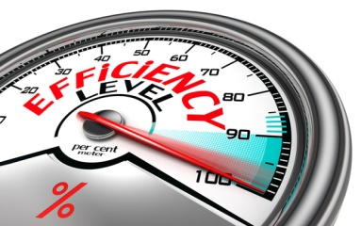

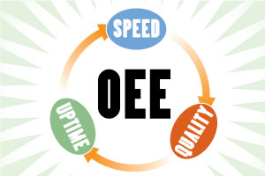
IOT (Internet Of Things) Solutions For OEE & OPE for Phase - III
ACHIEVING EFFICIENCY

Slide 2

Index :
System Architecture
2. OEE Concept
3. OEE- Reporting Dashboard
4. Eastro Scope Of Work
5. M&M Scope Of Work
6. Advantages Of OEE

Slide 3
2. OEE Concept
OEE (Overall Equipment Effectiveness) is a universally accepted method for measuring the improvement potential of a production.Measuring makes it easier to improve, and improving productivity (by eliminating waste) is the core objective of Lean Manufacturing. OEE also provides a critical link between measurement and improvement. It directly ties to the losses, which provide a practical and actionable roadmap for improving manufacturing productivity.

Slide 4
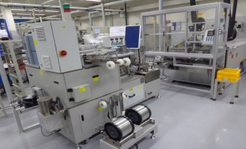
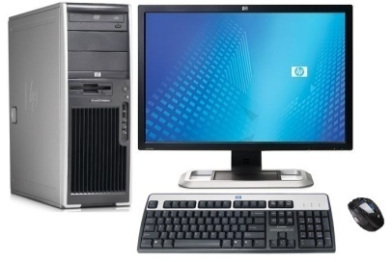

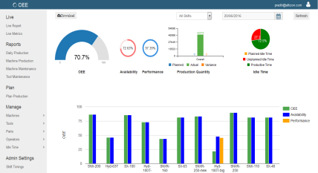
2.a System Architecture
Online OEE Monitoring
Equipment
Assembly Machine - I
Internal Server
Pro-face Gateway
Pro-face Data Management Software
Assembly Machine - II
Third party Application
Assembly Machine - XVII
Reporting Dashboard
PHASE - I
PHASE - II
PHASE - III

Slide 5
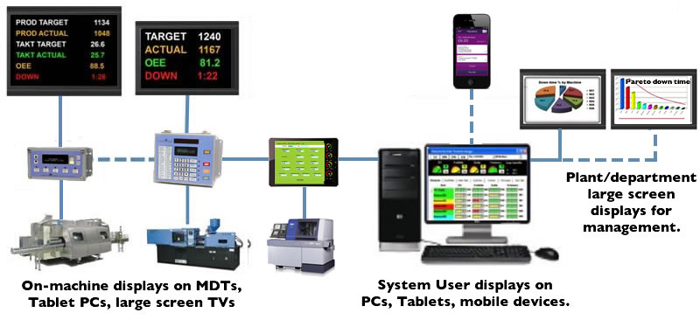

2.b System Architecture
Online OEE General Architecture

Slide 6

4.a Online OEE Monitoring- Sample Dashboard
Equipment
PHASE - I
PHASE - III

Slide 7
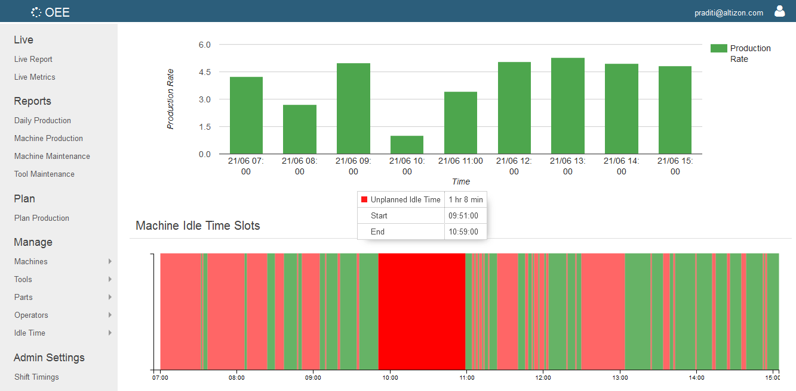
4.b Online OEE Monitoring- Reporting Dashboard
Third party Application
PHASE - I
PHASE - III

Slide 8
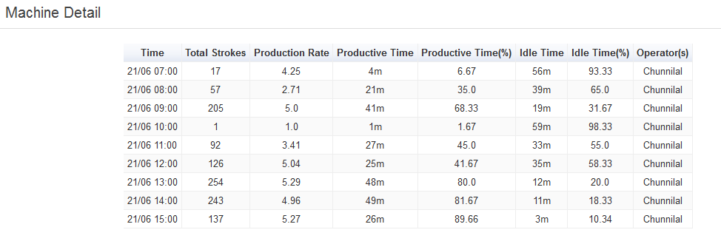
4.c Online OEE Monitoring- Sample Dashboard

Slide 9
4. EASTRO CONTROL SCOPE
Provide Software required For Server Connectivity
VB Base Software for GUI – Dash Board
Services Related To OEE Reporting & Logging of Data
Customize GUI
Provide Training For M&M Maintenance Team

Slide 10
5. M&M SCOPE
Provide Internal Server or Standalone Server with Windows License O.S. ,MS-OFFICE, Oracle Server License
Server Min Hardware Spec. Requirement :
CPU i3 and above, 8GB Ram, 500 GB HDD For 17 Machine Data
3. Laying of Ethernet Cables From Machines to Server
4. Provide Ethernet Switches
5. Supervise on activity & taking up shutdown for individual machine for specific time period
6. Approval & Suggestions from M&M IT Team for Successful implementation of Project.

Slide 11
6. ADVANTAGES OF OEE
1. Get the best performance from the machinery as we are
using Ethernet Data Connectivity Technology.
2. Ability to measure and decide Performance and maintenance
Parameter with same Infrastructure.
3. Facilitates the work of all people involved in the
manufacturing process
4. Return on Investment (ROI)
5. OEE gives 100% Accurate measures & values digitally than
pulse methods.
6. Scalable & Modular System to Execute Complete Project in
Phases

